Slide 1
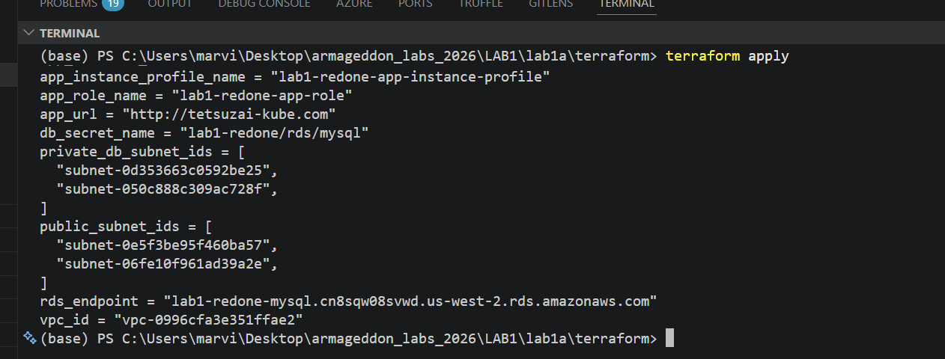

Slide 2
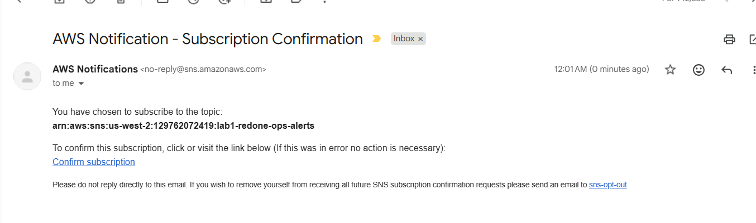
Sns success!!

Slide 3
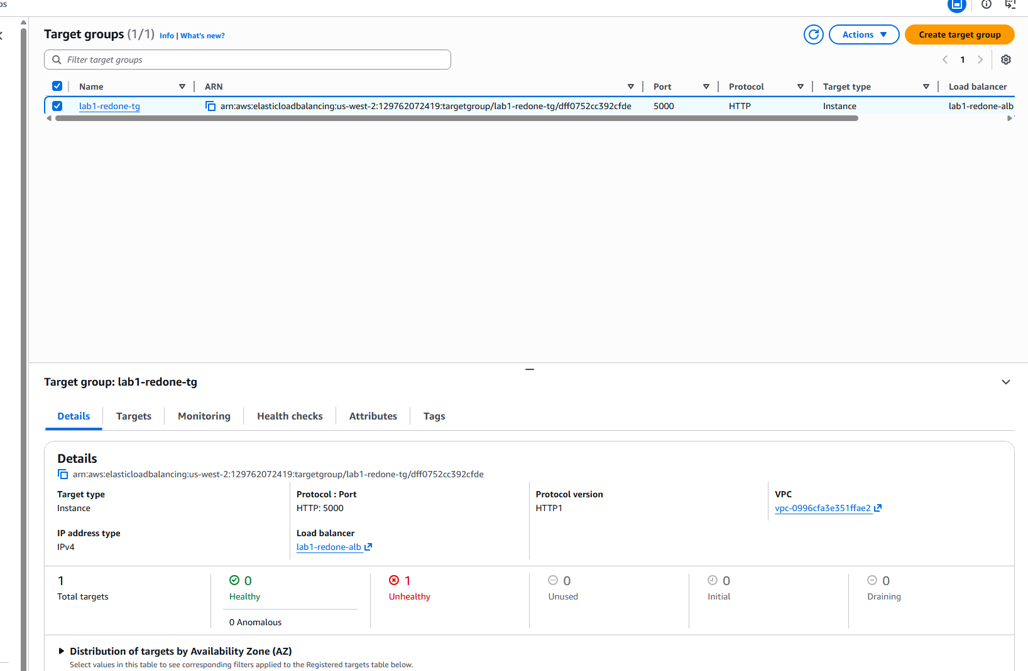
Target group unhealthy
Removed an inbound rule to test it. For testing purposes only

Slide 4
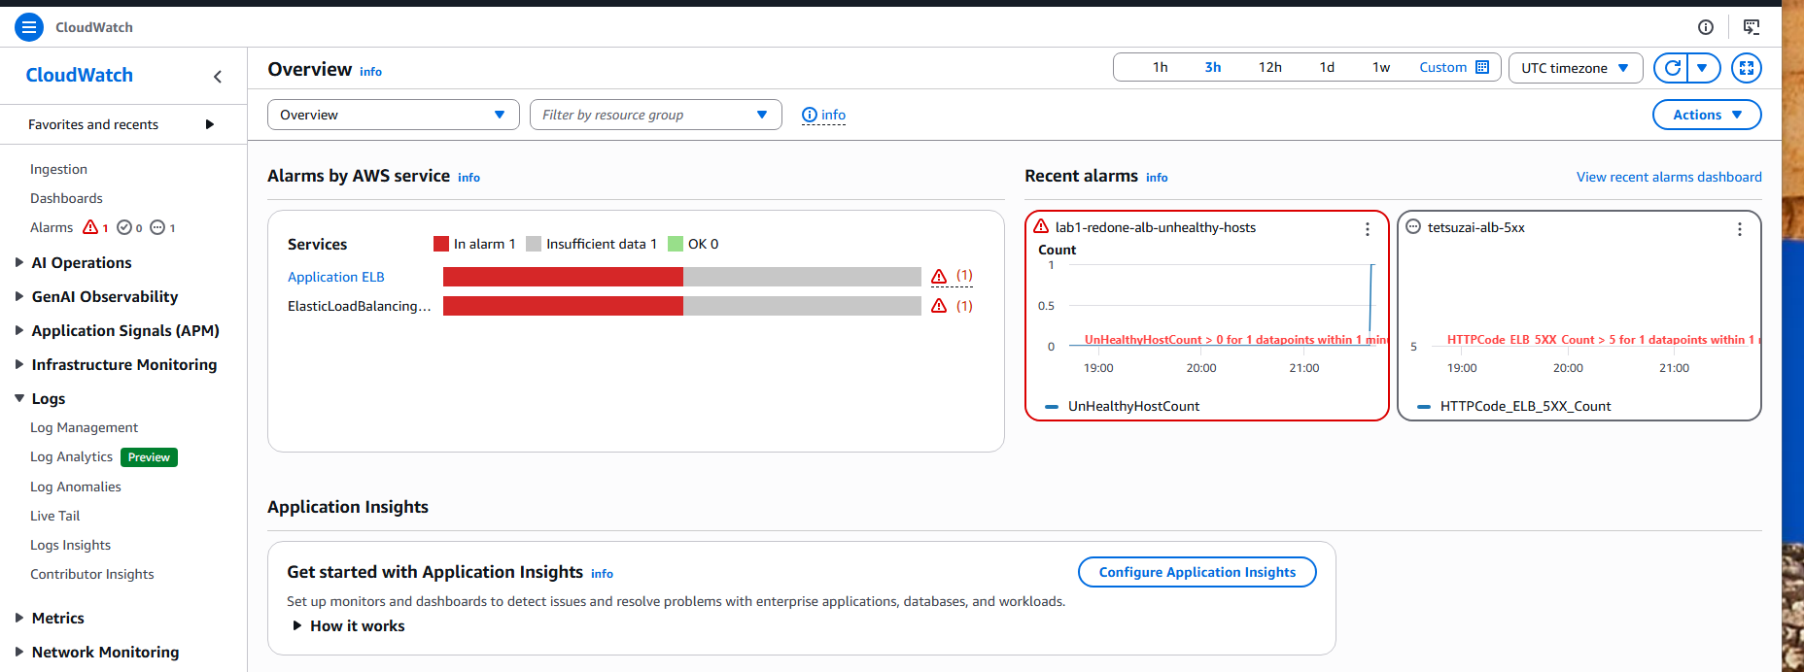
Cloud watch alert

Slide 5
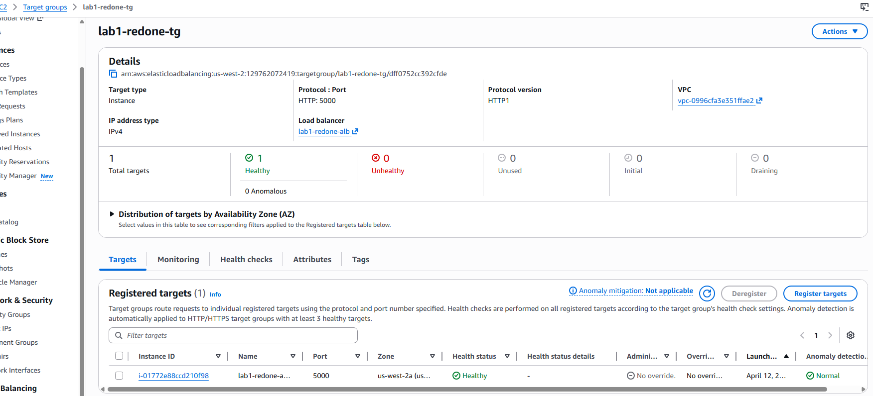
Restored the inbound rule

Slide 6
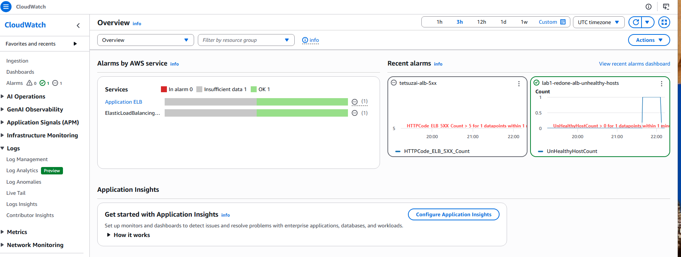
Back to health

Slide 7
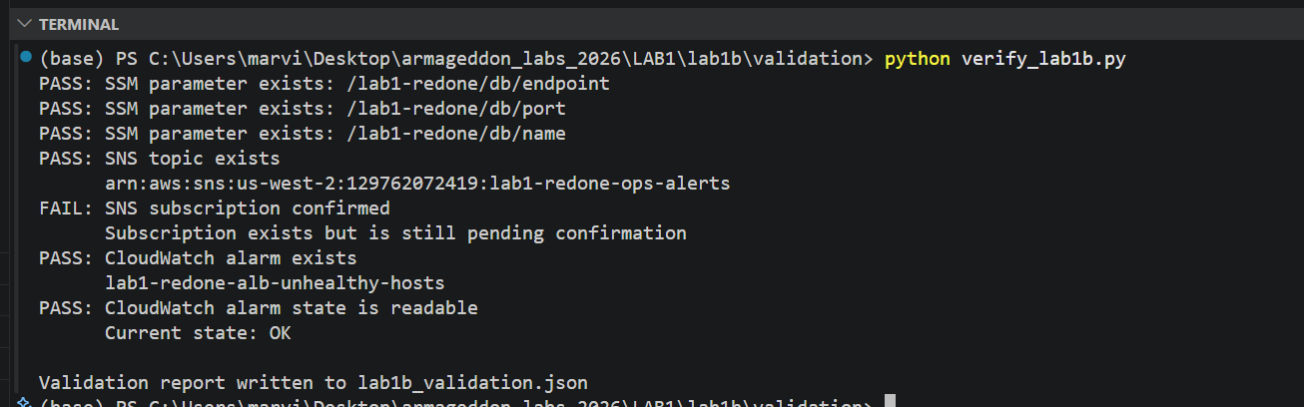
Python evidence for lab 1b

Slide 8
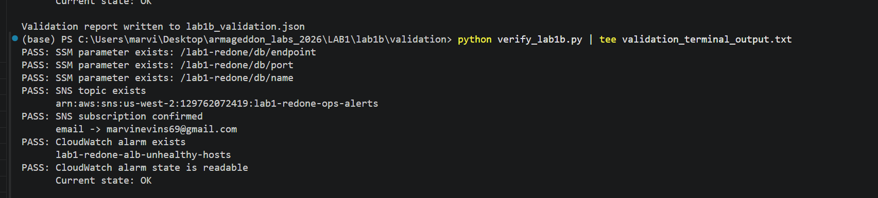
File in my repo

